Slide 1
Software Engineer QA Co-Op
Prajesh Jain
May – Dec 2019

Slide 2
Final Co-Op Presentation
Agenda
01
About Me
03
Highlights
Recap
02
Role, Responsibilities & Projects
04
What’s Next?

Slide 3
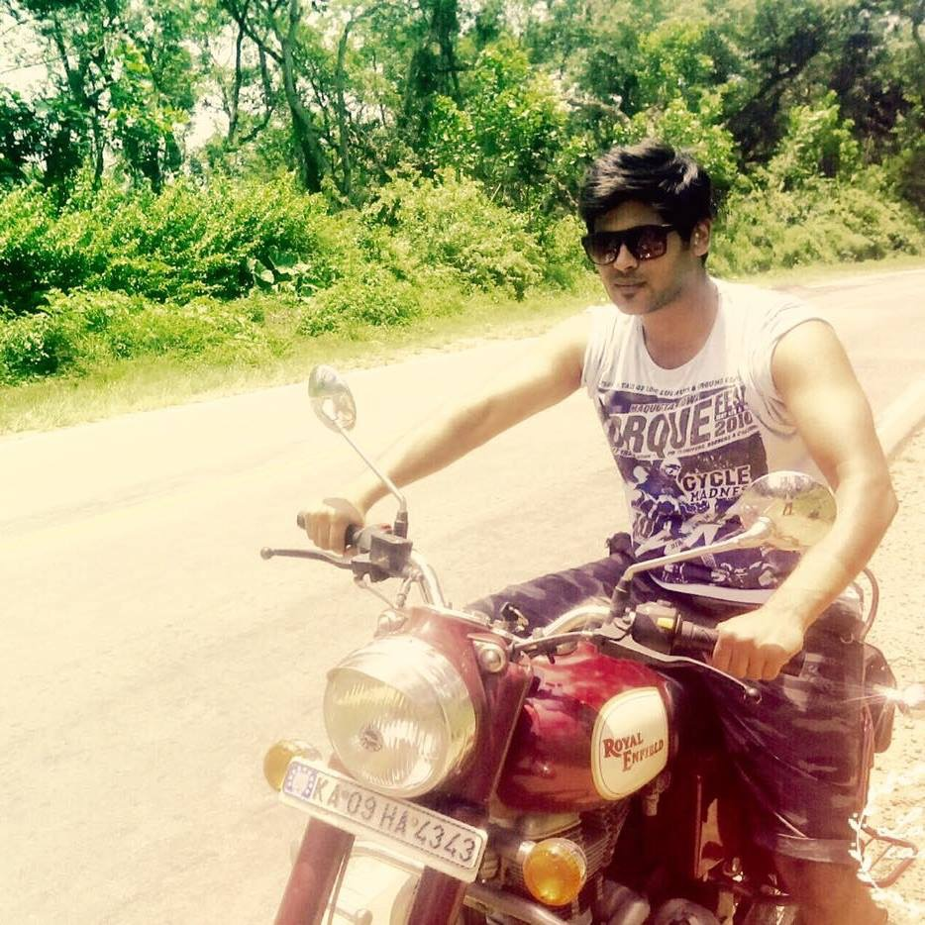




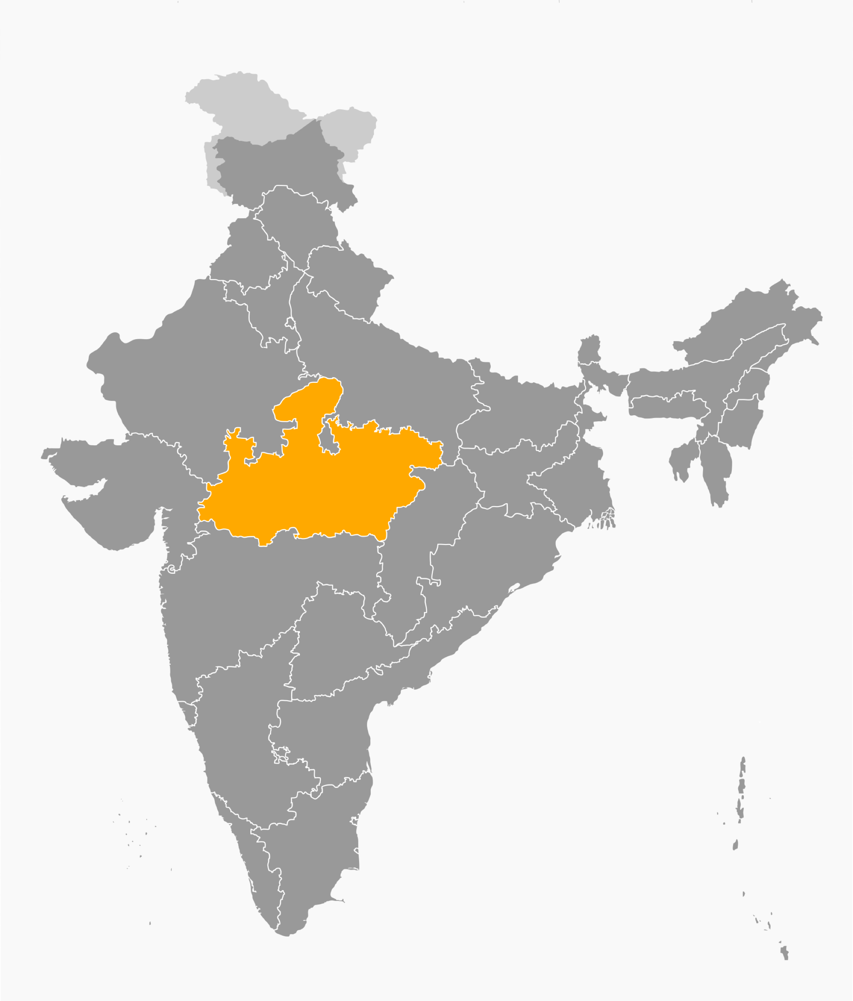



About me
Graduate Student at Northeastern University
Candidate for Masters of Science in Information Systems
1st and only Co-Op:
Previous Work Experience

Slide 4



My Role at iRobot! Software Engineering QA Co-Op
Technology Stack
Typical day to day tasks:
Identifying test cases to be automated
Developing test scripts covering test cases for NA, EMEA and CA sites
Execution of test cases for NA, EMEA and CA sites
Regression Testing on Mobile/ Desktop during sprint
Defect tracking and defect logging
Automation completed So far:
Over 150 test scenarios automated so far
Worked on automation for Mercury and DevOps projects
Created Scripts for 14 sites from NA, CA and EMEA regions
Automated sites of call center for NA, CA and EMEA with capabilities of placing service orders

Slide 5







Role, Responsibilities & Projects
Continued
Automated all the payment methods including card payment, Paypal, Affirm for NA. Ideal and Sofort for EMEA.
Typical automation scenarios include end to end flow of shopping cart for Roomba, braava, accessories and bundles as different products
Developed HTML report which captures every detail of execution including test scenario executed, failed and Passed. It also includes the screenshots for failed scenarios with the reason of failure
Developed xls report to capture order details for each order which gets generated after every execution cycle
Developed scripts to test Promo codes

Slide 6
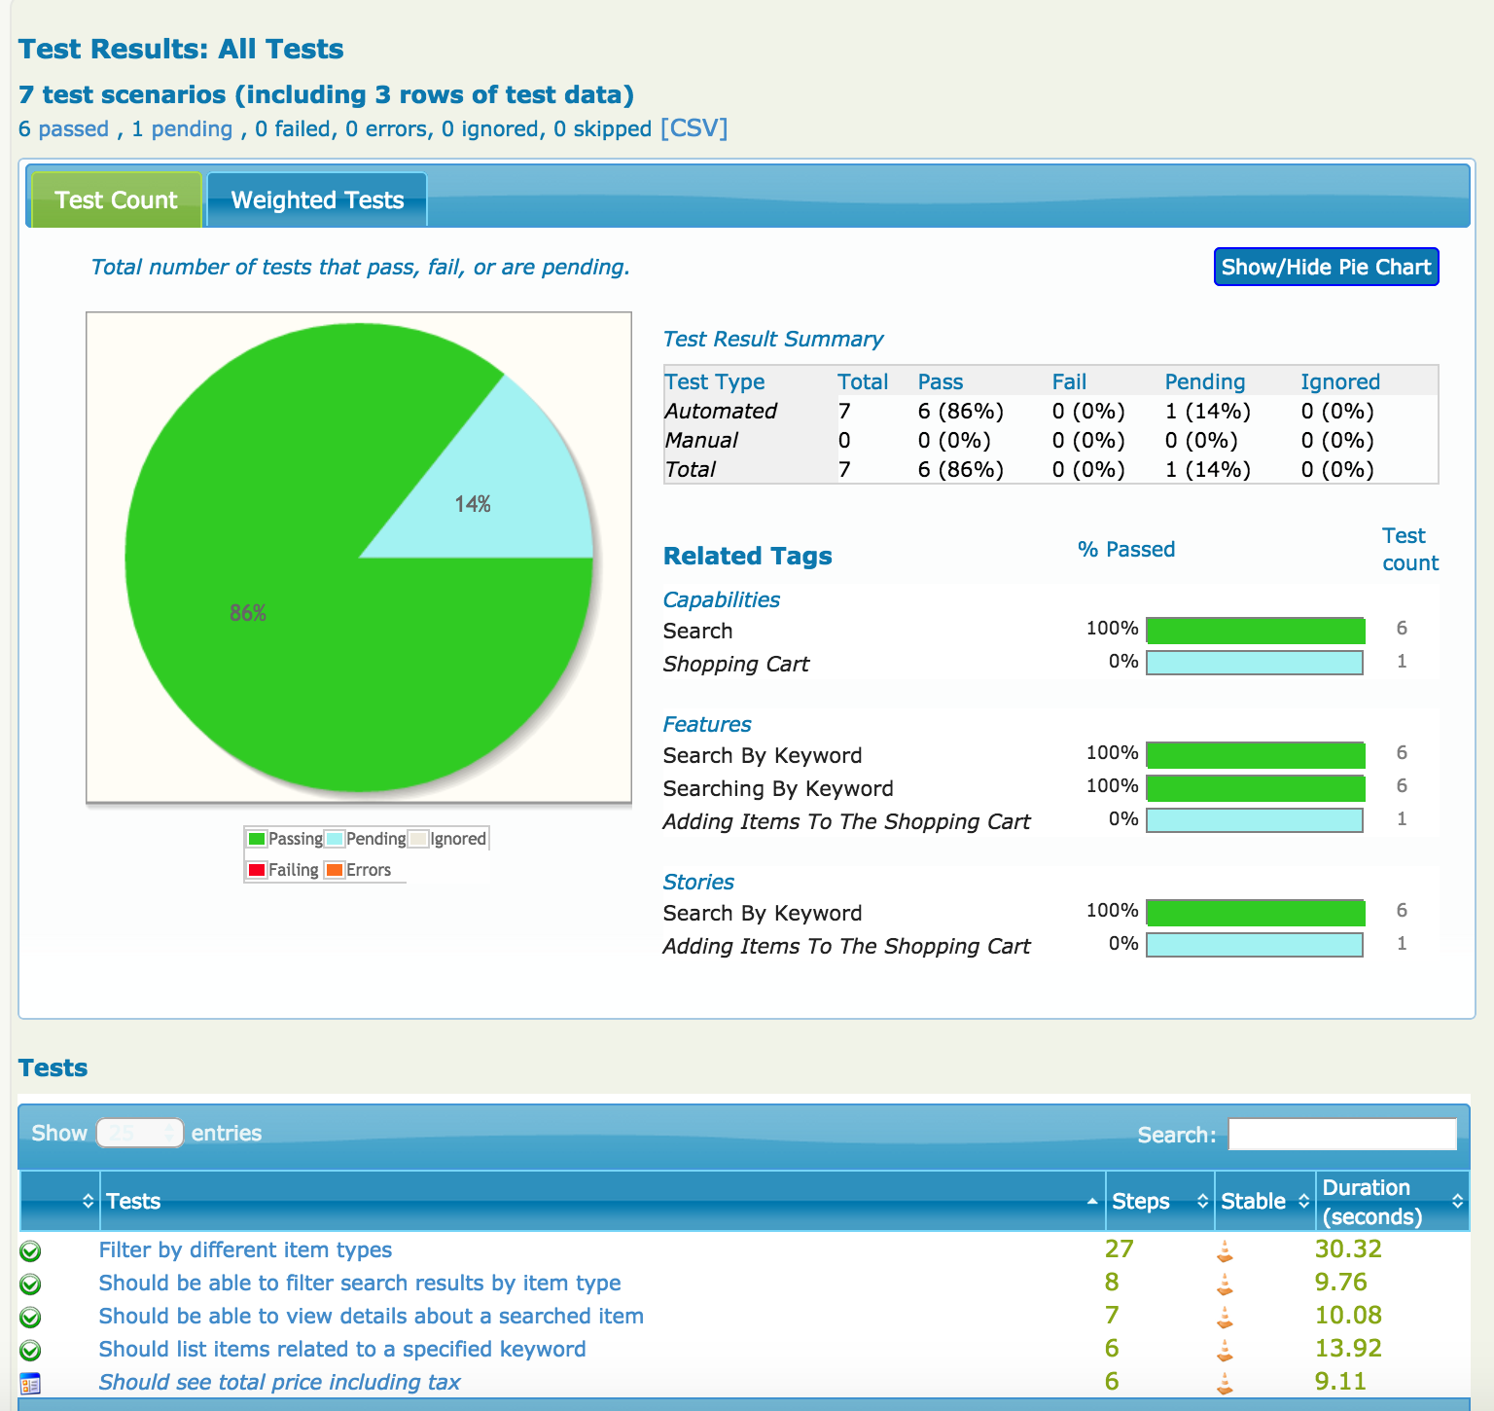
Continued
Test Execution Report
Developed self-contained HTML summary report, containing an overview of the test results, and a configurable breakdown of the status of different areas of the application
Created scripts to capture screenshots for test case failure and integrated it with the report
Captured execution timing for each scenario inside the report
Fastest execution timing achieved for a typical end to end shopping scenario is 4 sec

Slide 7
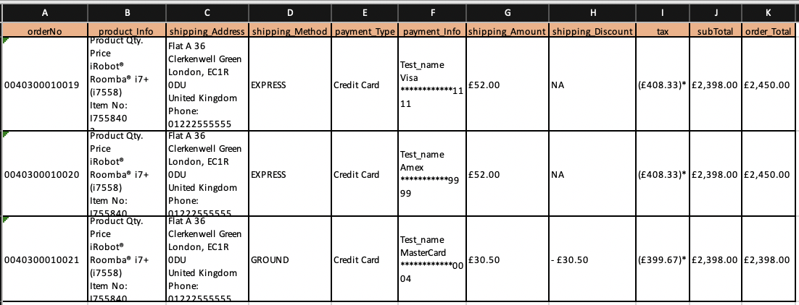
Continued
Order Detail Report
Developed xls report to capture order details through code
Created a utility function to capture multiple orders detail in the report
Manually creating this report is a tedious process and creating this report through code saved ~ 10 minutes for capturing details of each order
It hardly takes 5 seconds to generate this report after the test execution

Slide 8
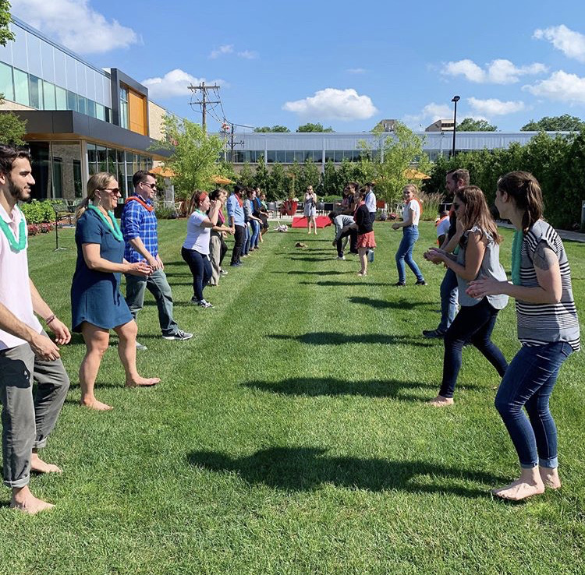
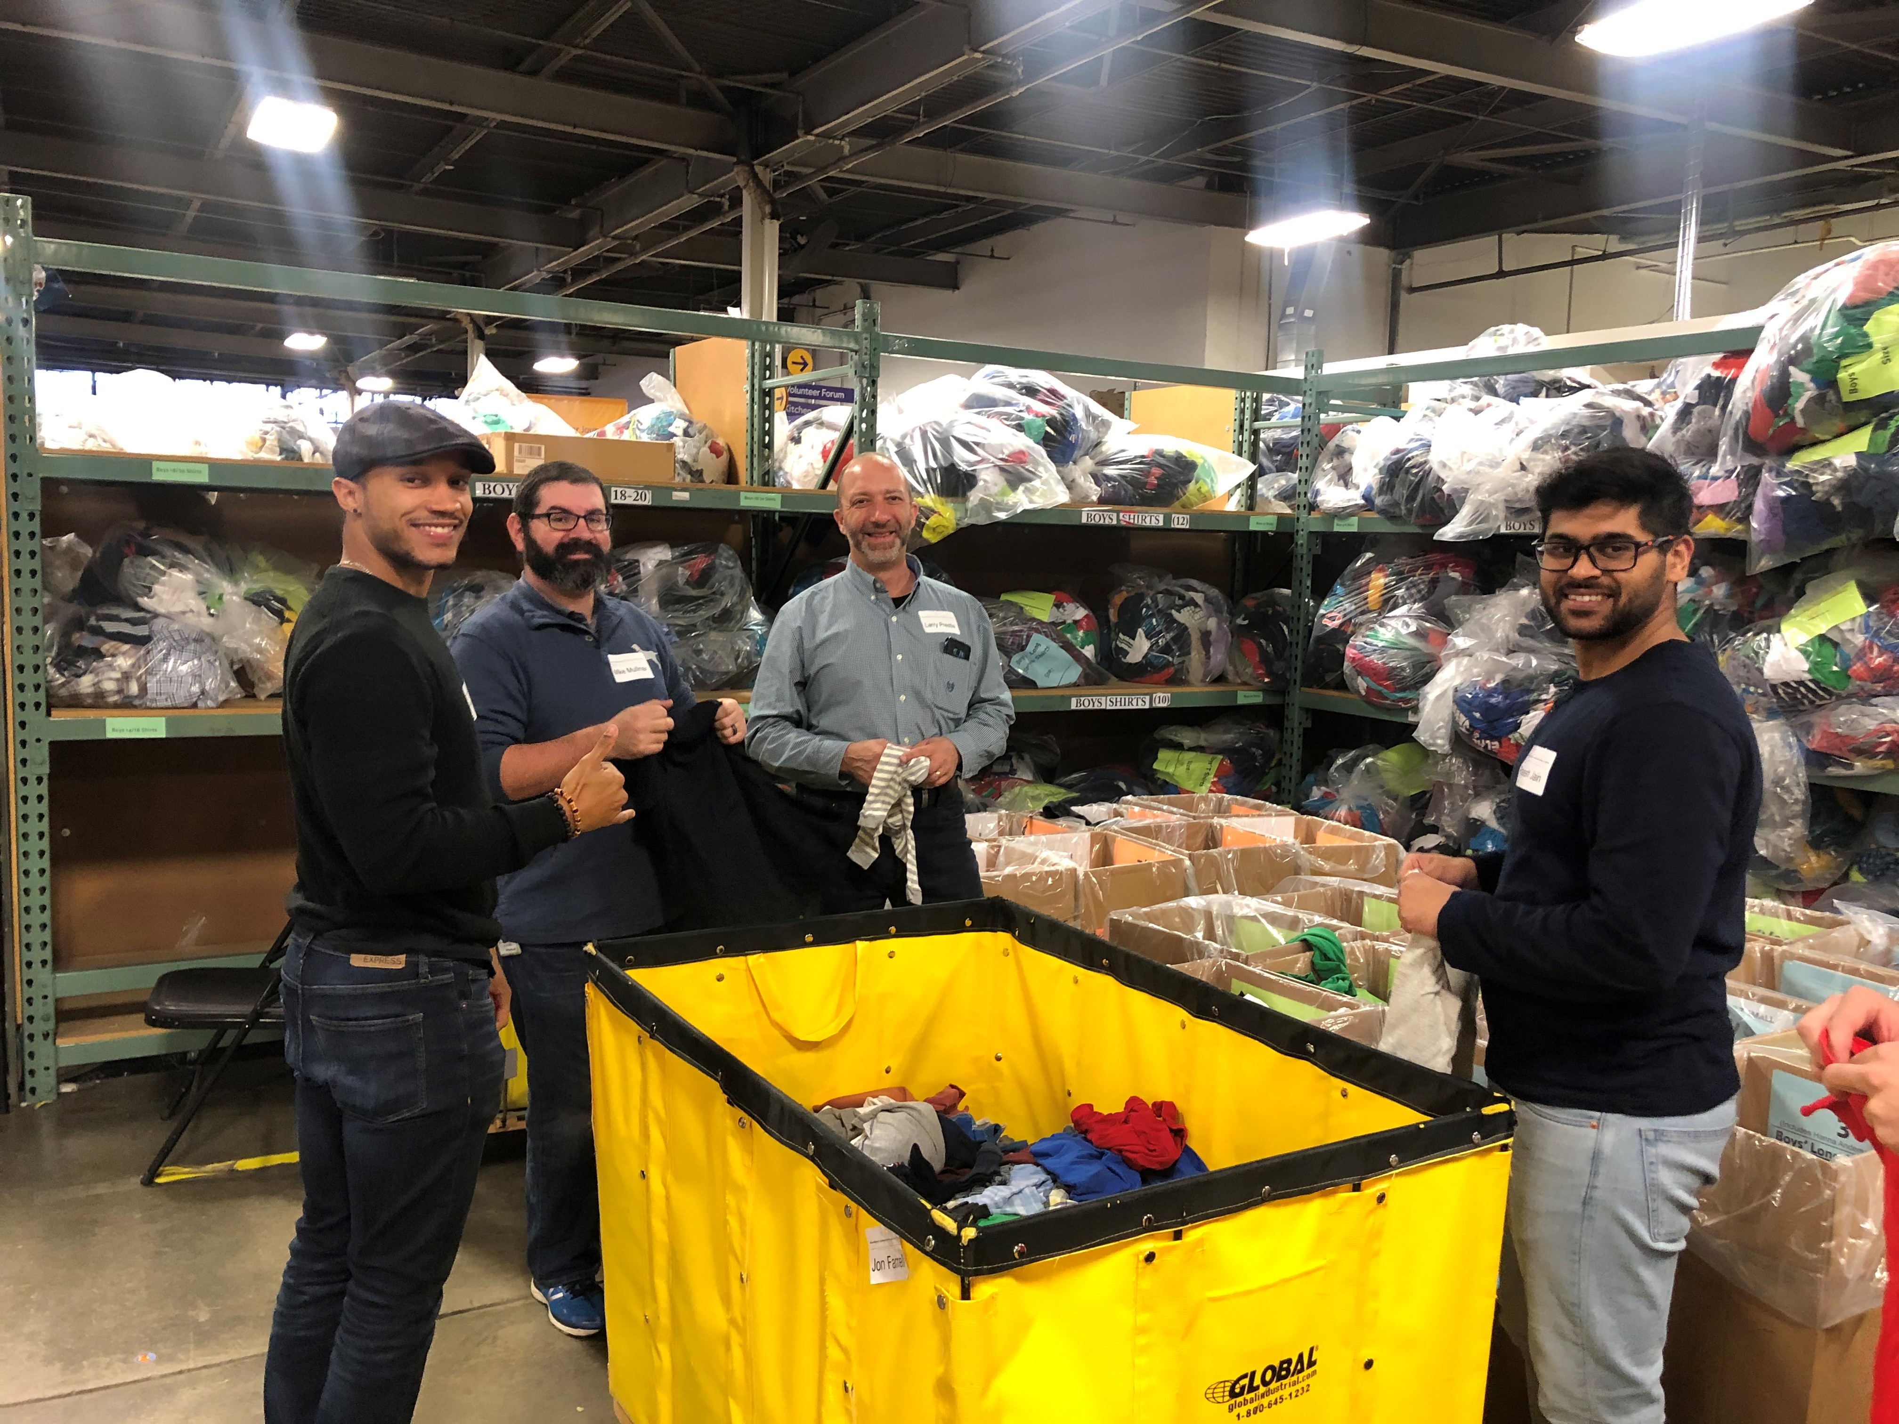
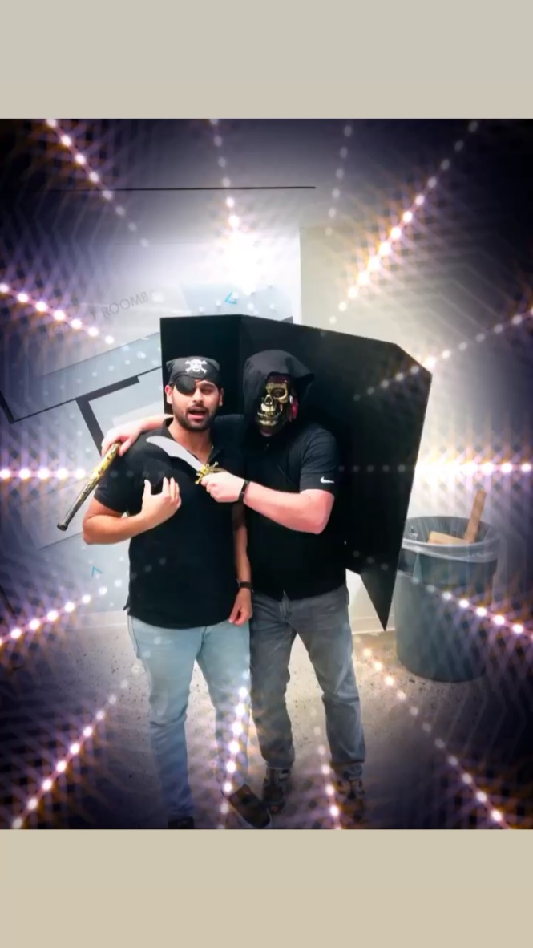
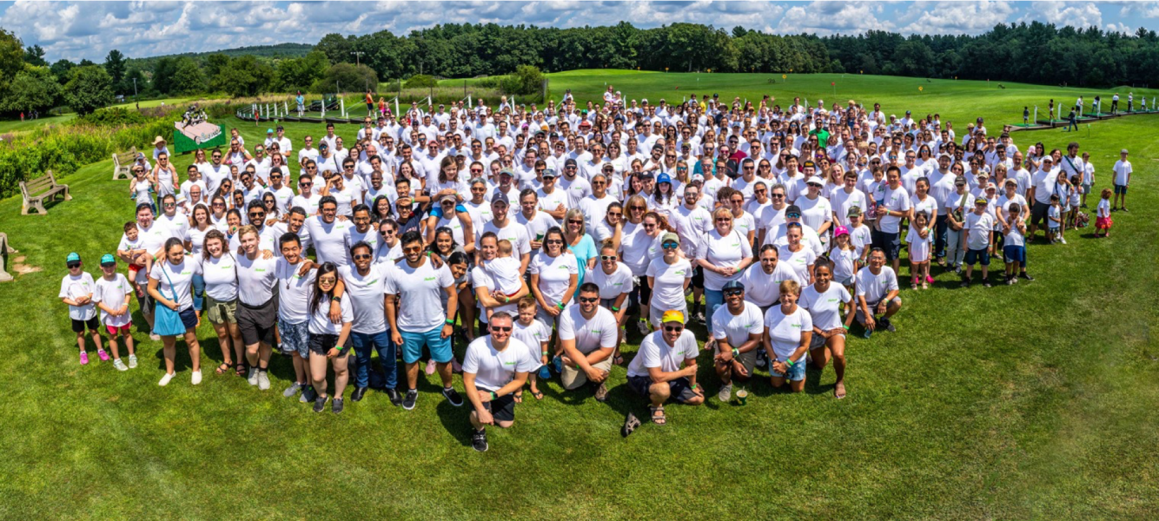
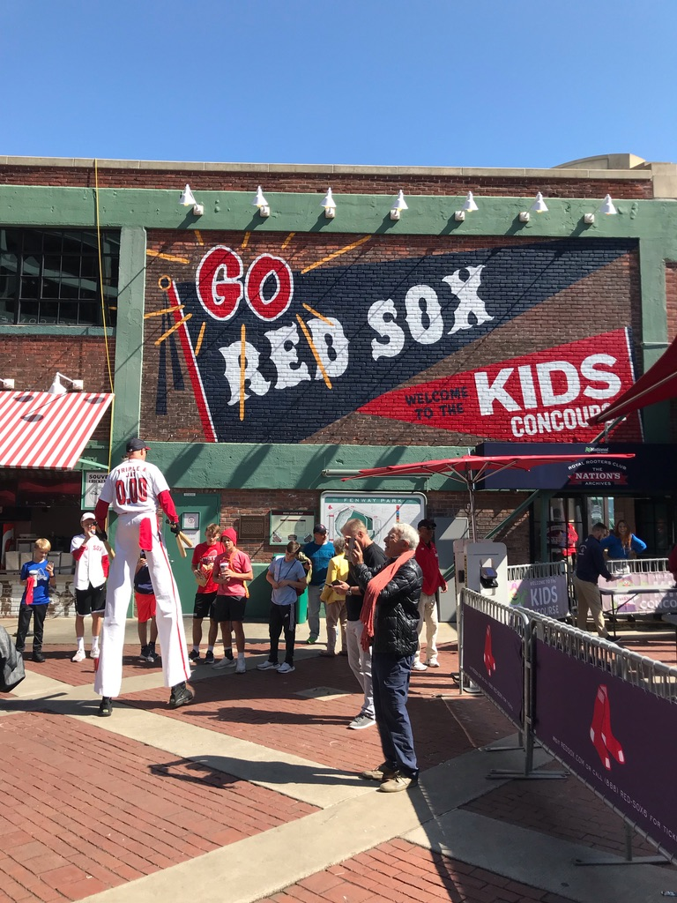
Highlights
Offsite Event
So many!
E-waste bins
Summer Party 2019
Halloween @iRobot
Fall Co-Op events
Bagel Fridays
Offsite with marketing team
Fall Co-Op event
Halloween
Summer Party
Stem fair

Slide 9




What’s Next?
Last Semester at School
Trip to India
Full time Preparation and search

Slide 10

Thank you!
Any Questions?
jain.prajesh@gmail.com
Prajesh Jain

